Slide 1
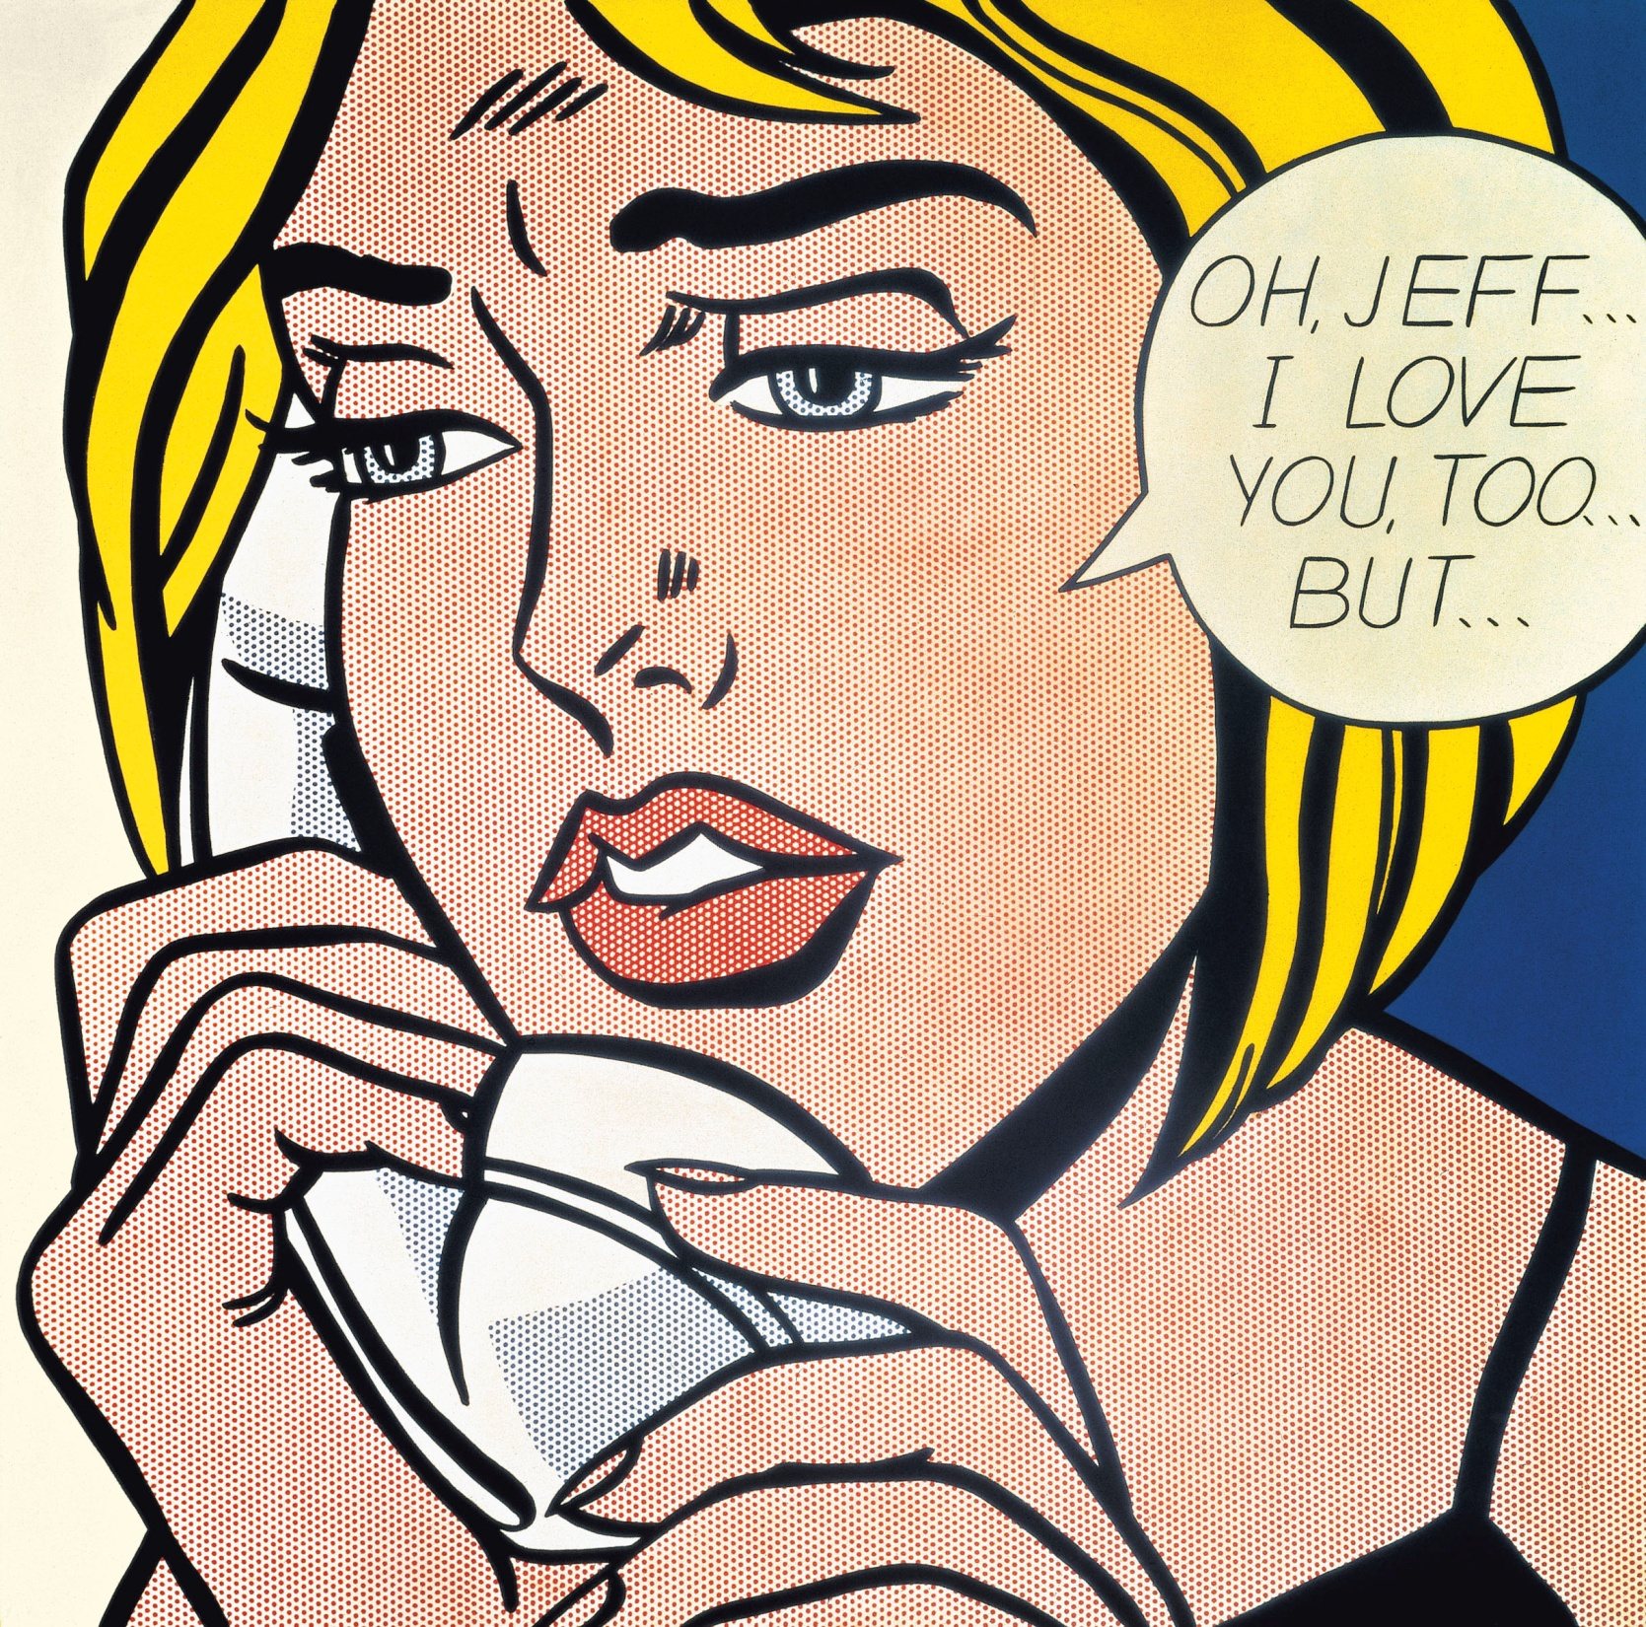
THAT’S WHY THEY CALL ME SUPER CIVIL SERVANT !
OH, JEFF…
YOU ‘RE THE ONLY ONE WHO COULD SOLVE MY PROBLEM!
Notes:
Kunstwerk voor de galerij

